Slide 1
INTRODUCTION TO
CANCER GENOMICS
Jan 03 2025
Giảng viên: TS. Lưu Phúc Lợi
Email: Luu.p.loi@googlemail.com
Zalo: 0901802182

Slide 2
Content of Lecture
The basics of cancer biology
Oncogenesis
The hallmarks of cancer
The tumour microenvironment
Cancer Genomic Databases
cbioportal

Slide 3
The basics of cancer biology
Cancer is a disease of the genome.
Environmental factors can certainly influence the growth and spread of cancer, but the changes that first lead to this devastating disease originate inside the cell.
Once believed to be a single disease, we now know that cancer is in fact a group of related diseases characterised by cells dividing uncontrollably and spreading into surrounding tissues.
https://frontlinegenomics.com/a-guide-to-cancer-genomics/

Slide 4
Oncogenesis
The transformation of healthy cells into cancerous cells (otherwise known as oncogenesis) is a complex, multi-step process.
This process begins with deleterious changes within a cell’s genome, which can have environmental, chemical or even viral origins.
The development of next generation sequencing technologies in recent years has shed light on these cancer-causing genetic changes, which are largely split into three groups – mutations, gene amplifications and chromosomal rearrangements.
By altering the expression or structure of critical genes, these changes promote the excessive growth of cancer cells, eventually allowing them to spread and infiltrate other tissues.
Several hundred critical genes have now been identified which, when mutated, play a direct role in cancer development.
Termed “driver genes”, most are typically associated with regulation of cell growth, with mutations in cell cycle regulators and tumour suppressor genes being frequently observed. It is estimated that 1 – 10 driver mutations are required for oncogenesis, although this number has been shown to vary depending on cancer type.
In contrast, somatic mutations caused by the increased genetic instability of cancer cells, or mutations present in cells before oncogenesis, are known as “passenger mutations”. These do not play a direct role in tumour formation or cancer development.
https://frontlinegenomics.com/a-guide-to-cancer-genomics/

Slide 5
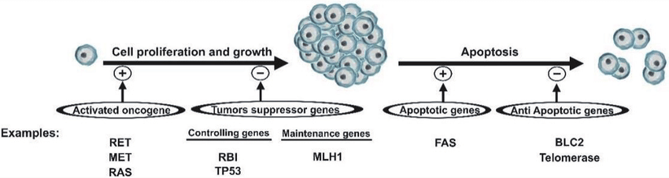
Oncogenesis Example
Mechanism of oncogenesis. General scheme for mechanism of oncogenesis by proto-oncogene activation, loss of tumor suppressor gene expression, activation of anti-apoptotic genes or loss of pro-apoptotic gene expression. The effect of the genes that induce a process is shown as +, while the effect of the genes that suppress a process is shown as −. Modified from Thompson and Thompson [8].
DOI:10.5772/intechopen.85894

Slide 6
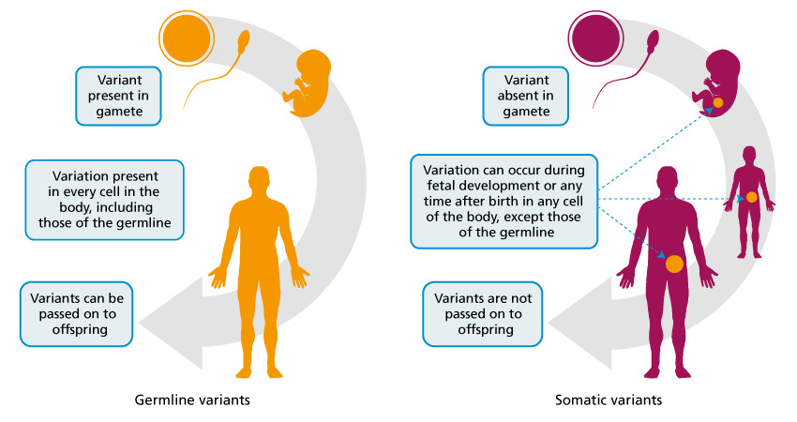
Inherited (germline) genomics variants vs acquired (somatic) variants
https://www.genomicseducation.hee.nhs.uk/cancer-genomics/

Slide 7
Two kinds of cancer variants: Inherited variants vs Acquired variants
Inherited variants
Inherited genomic variants are also called germline variants. These variants are present in almost all of a person’s cells, and some rare variants increase the person’s chances of developing cancer. It is important to identify when a patient has this kind of germline variant, as it can have implications for their clinical care.
A patient with this type of variant may be offered additional screening or prophylactic surgery. For example, patients with particular BRCA1 and BRCA2 gene variants may opt to have a preventative mastectomy or oophorectomy.
It is also important to consider the implications for the patient’s family, as appropriate testing can identify other at-risk relatives who may be able to take measures to reduce their chance of developing cancer.
Acquired variants
Acquired genomic variants are called somatic variants, and these variants are present only in cancer cells. These variants are not inherited and cannot be passed on to any children.
Somatic variants can be the result of exposure to environmental factors, such as ultraviolet light, smoking, radiation and alcohol, or they can be entirely random. Each time a cell divides, errors might be introduced. While there are many mechanisms within the cell to correct these errors, occasionally they are missed.
https://www.genomicseducation.hee.nhs.uk/cancer-genomics/

Slide 8
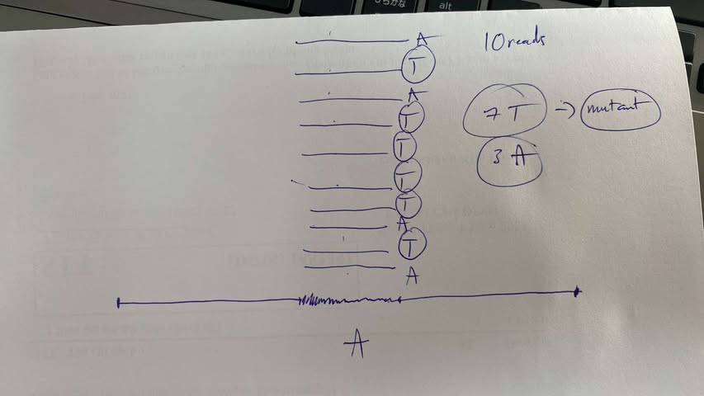
Depth of somatic mutation

Slide 9
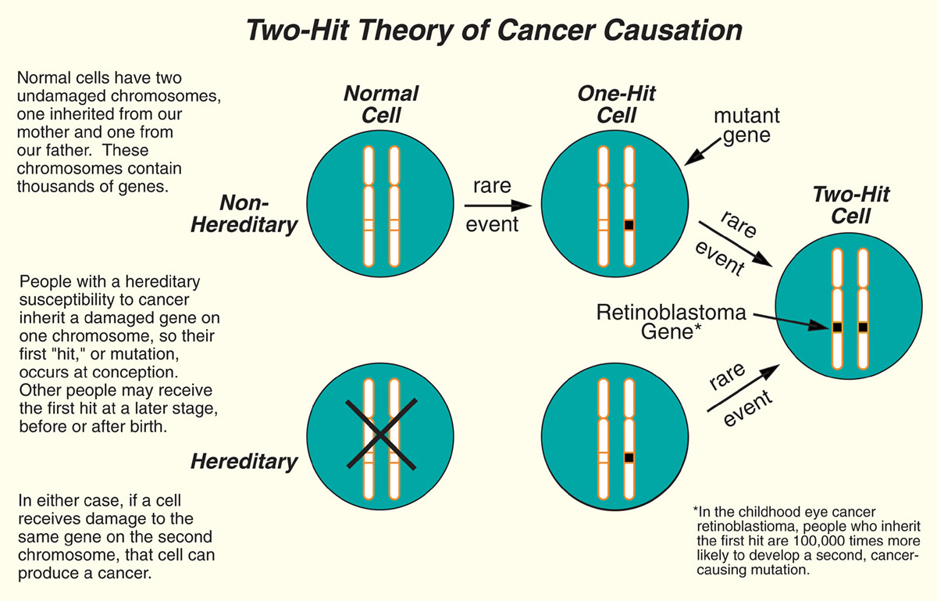
https://www.foxchase.org/about-us/history/discoveries-fox-chase-research/knudsons-two-hit-theory-cancer-causation

Slide 10
Refining treatment
Some genomic variants within the cancer genome can be used to work out the most appropriate treatment for the patient. Some variants can make the person more, or less, likely to respond well to particular treatments.
For example, tumours with certain variants in the EGFR gene respond well to EGFR-inhibitor drugs, but those without such variants do not. So two people with the same diagnosis of breast cancer may have different treatments based on the genomic information from their tumour.
Novel treatments can also be identified by sequencing the tumour’s genome.
https://www.genomicseducation.hee.nhs.uk/cancer-genomics/

Slide 11
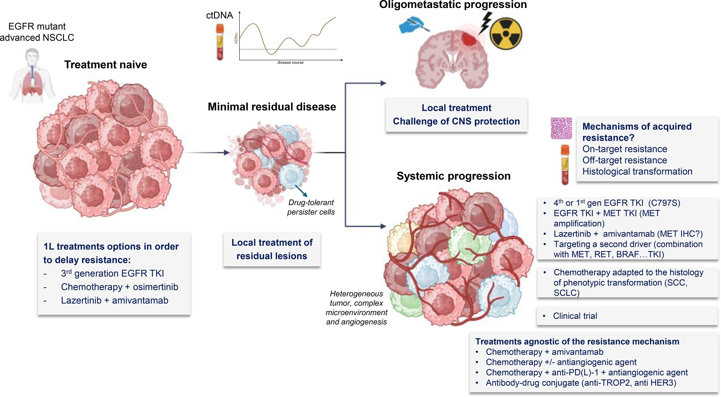
Refining treatment
https://www.lungcancerjournal.info/article/S0169-5002%2824%2900429-X/fulltext

Slide 12
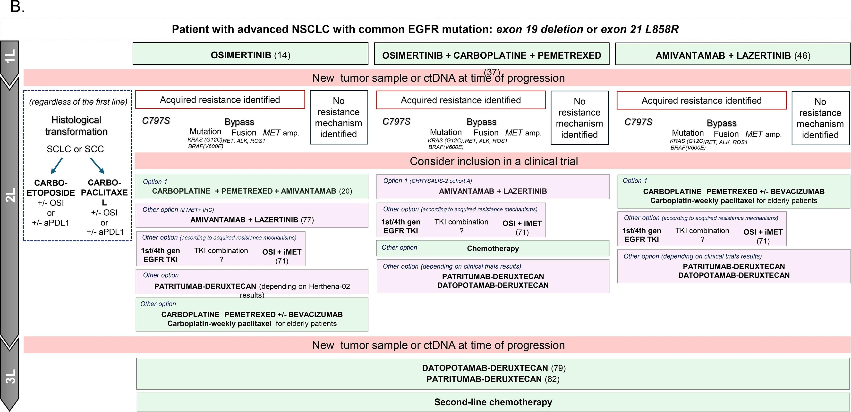
Refining treatment
https://www.lungcancerjournal.info/article/S0169-5002%2824%2900429-X/fulltext

Slide 13
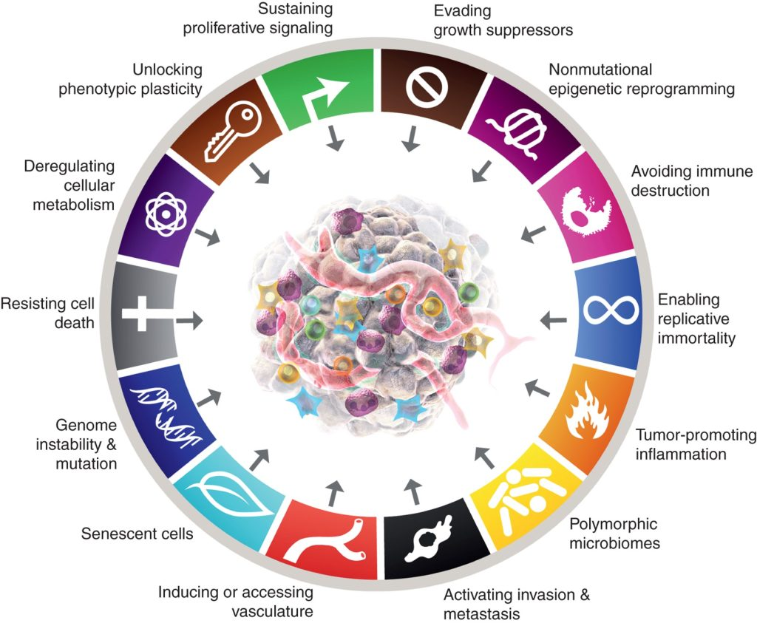
The hallmarks of cancer
Several of these malignant traits involve critical genomic modifications that allow cancerous cells to remain in the cell cycle pathway.
Due to the error-prone nature of DNA replication, the cell cycle contains essential checkpoints which evaluate the genomic integrity of the cell and prevent genetic errors from being copied into the next generation of cells.
Should a defective cell be recognised, the checkpoints can trigger a variety of signalling pathways which prevent progression through the cell cycle.
Normally, excessive DNA damage triggers repair pathways or an induced cell death mechanism – apoptosis – to either fix or destroy abnormal cells.
Cancerous cells employ a variety of methods to avoid this fate.
This includes developing mutations which enable sustained proliferative signalling, replicative immortality, and resistance to cell death mechanisms.
https://frontlinegenomics.com/a-guide-to-cancer-genomics/

Slide 14
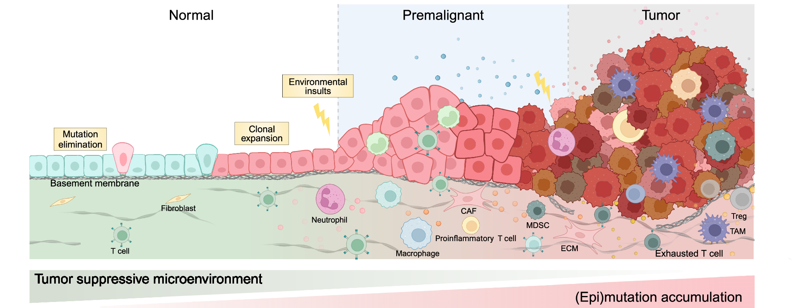
Tumour development
Following the initial genetic changes that trigger oncogenesis, the subsequent uncontrolled growth of cancerous cells results in the development of a tumour in the primary site.
Defined as any mass formed from the abnormal proliferation of cells, tumours may be either benign or malignant, depending upon their ability of invade surrounding tissue or spread to secondary sites within the body.
Notably, only malignant tumours are considered cancerous.
The development of tumours is a long, complex process which can take many years after the initial driver mutations occur.
It is estimated that human tumours are only detectable once they number 10 – 100 billion cells, with researchers discovering that this process can take 10 years in breast and bowel cancers.
https://frontlinegenomics.com/a-guide-to-cancer-genomics/
https://www.nature.com/articles/s41392-024-01848-7

Slide 15
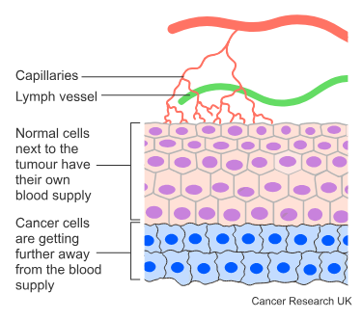
Blood supply and cancer
As the tumour gets bigger, its centre gets further and further away from the blood vessels in the area where it is growing. So the centre of the tumour gets less and less oxygen and nutrients.
Like healthy cells, cancer cells can't live without oxygen and nutrients. So they send out signals called angiogenic factors.
These encourage new blood vessels to grow into the tumour. This is called angiogenesis. Without a blood supply, a tumour can't grow much bigger than a pin head.
Once a cancer can stimulate blood vessel growth, it can grow bigger. It stimulates hundreds of new small blood vessels (capillaries):
to grow
to bring in nutrients and oxygen
https://frontlinegenomics.com/a-guide-to-cancer-genomics/
https://www.cancerresearchuk.org/about-cancer/what-is-cancer/how-cancers-grow

Slide 16
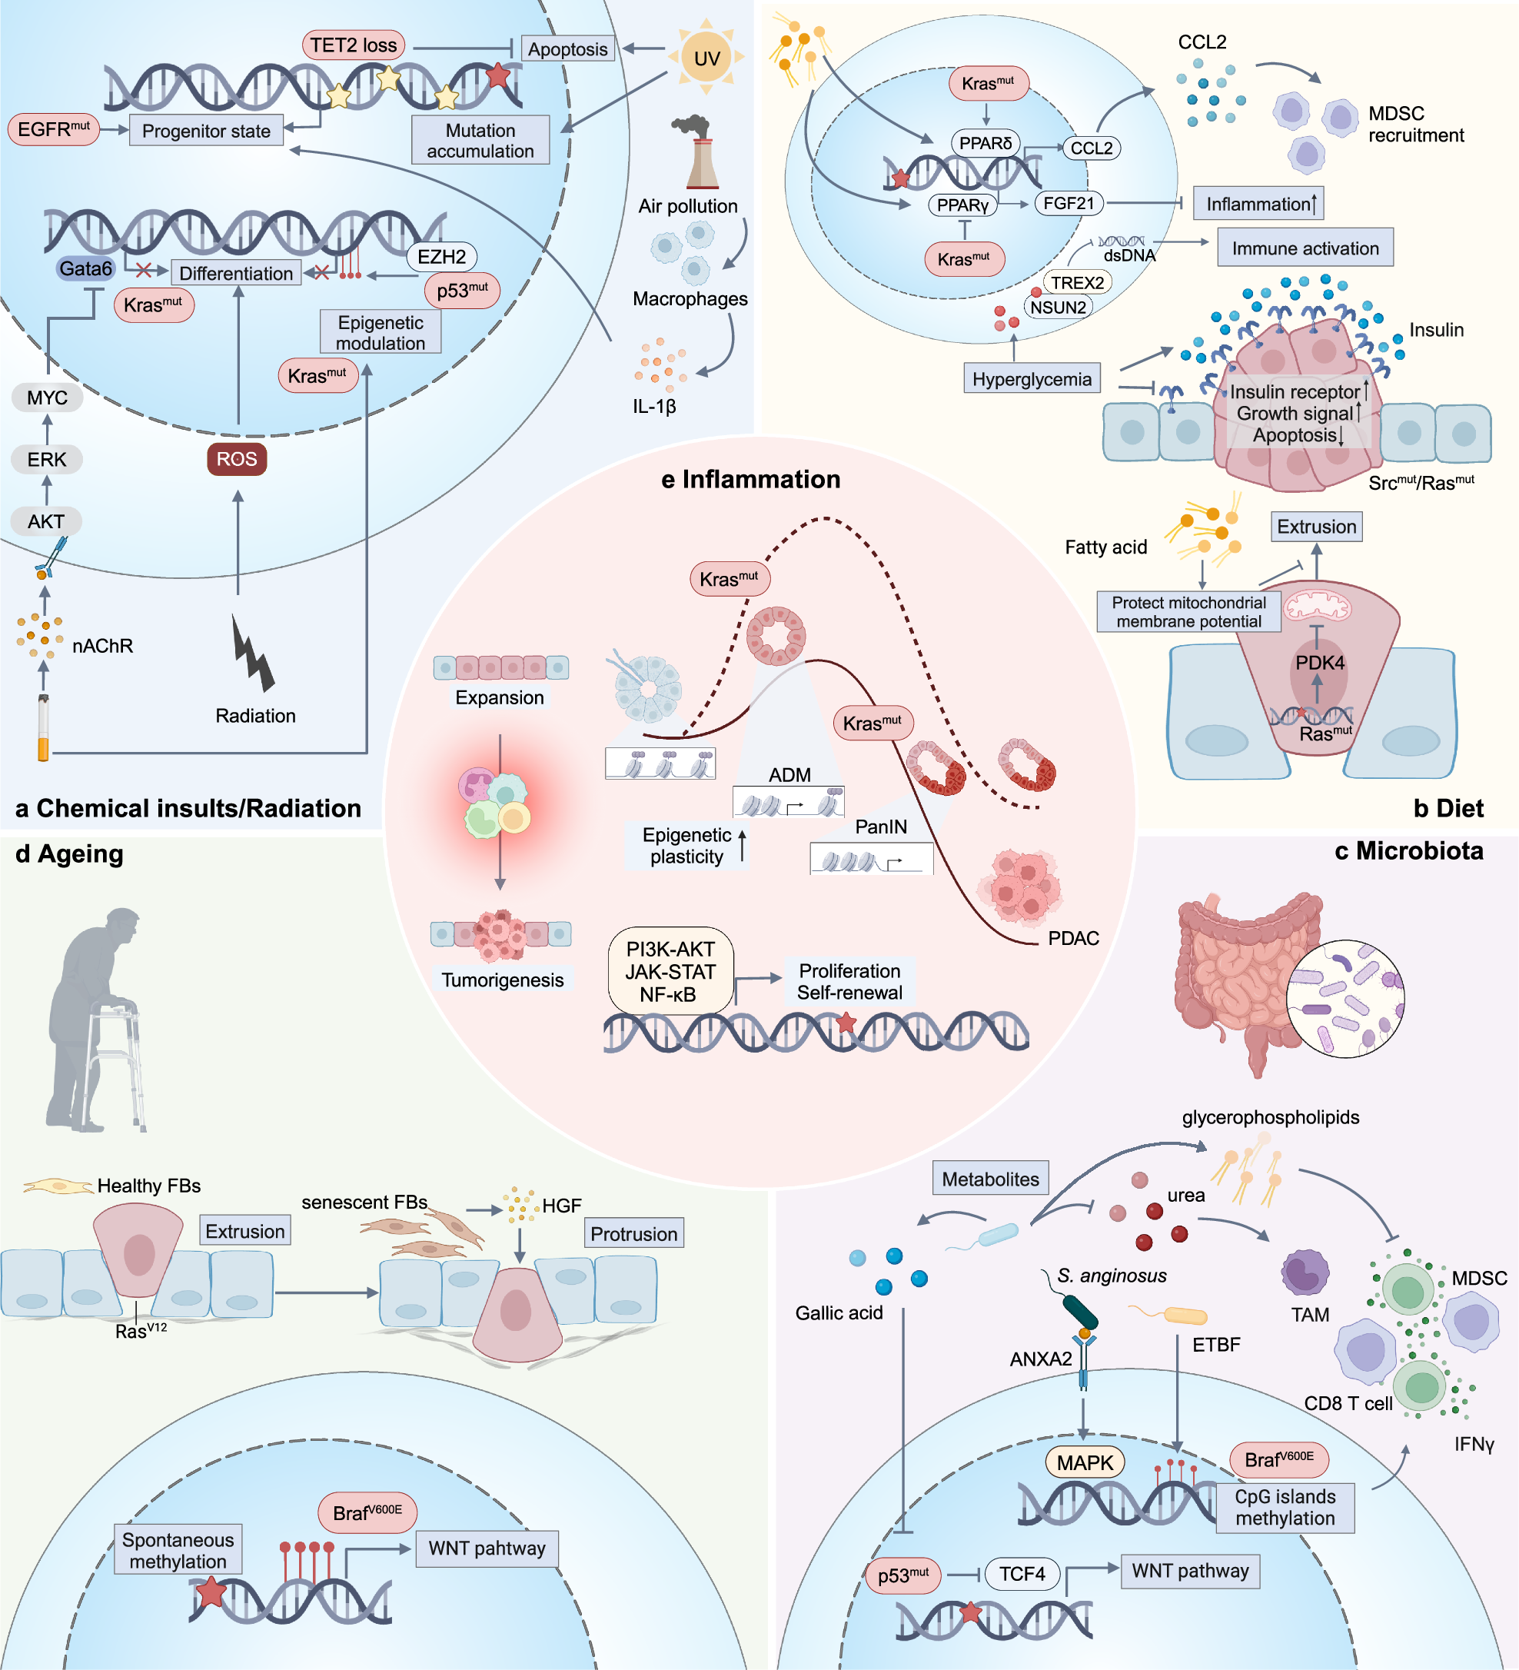
Interactions between oncogenic driver events.
a In addition to genotoxicity, chemical and radical insults can induce cell injury, differentiation, and apoptosis. Oncogenic mutations that can confer resistance to such injuries provide proliferative advantages. On the other hand, the insults stimulate proliferative and self-renewal pathways by transcriptional and epigenetic regulation. Immune cells can also be activated to regulate transformed cell fate and promote tumorigenesis. b Unhealthy diet patterns induce hyperglycemia and hyperinsulinemia, and further cause differential response to insulin signals, which can facilitate cells harboring Src or Ras mutation in gaining competitive advantages and promote tumorigenesis. High levels of fatty acids also promote retention of Ras-mutant cells in cell competition by metabolism remodeling and mitochondrial membrane potential restoration. In addition, fatty acid and glucose participate in tumorigenesis as signaling molecules by modulating immune response and inflammation. c Microbiota interacts with transformed cells to affect host DNA methylation, transcription, metabolism and immune microenvironment to have an influence on malignant transformation. d Aging induces senescent stromal cells to secrete SASPs, which can reverse the outcome of cell competition and promote EMT of the mutant cell. Aging also cause spontaneous methylation, further promoting mutation-driven tumorigenesis. e The pathological processes mentioned above can converge at inflammation, which releases tumorigenic potential of expansive clones by activating oncogenic pathways and increases epigenetic plasticity. For instance, in pancreatic inflammation induced plastic state, ADM, Kras-mutant cells are more likely to transform to malignant status, while in the absence of inflammation, Kras can only induce PanIN without progression to PDAC. EMT epithelial-to-mesenchyma transition, ROS reactive oxygen species, nAChR nicotinic acetylcholine receptor, MDSC myeloid-derived suppressor cell, PDK pyruvate dehydrogenase kinase, TCF4 T cell factor 4, HGF hepatocyte growth factor, TET2 tet methylcytosine dioxygenase 2, EGFR Epidermal growth factor receptor, UV ultraviolet, Gata6 GATA Binding Protein 6, EZH2 enhancer of zeste homolog 2, PPAR-δ peroxisome proliferator-activated receptor-delta, FGF21 fibroblast growth factor 21, CCL2 PDK4, pyruvate dehydrogenase kinase 4, ADM acinar-to-ductal metaplasia, PanIN pancreatic intraepithelial neoplasms, PDAC pancreatic ductal adenocarcinoma, ETBF enterotoxigenic Bacteroides fragilis, Created with BioRender.com
https://www.nature.com/articles/s41392-024-01848-7/figures/3

Slide 17
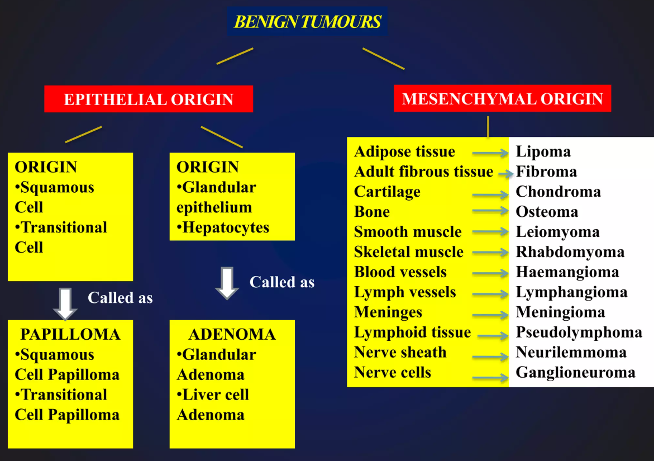
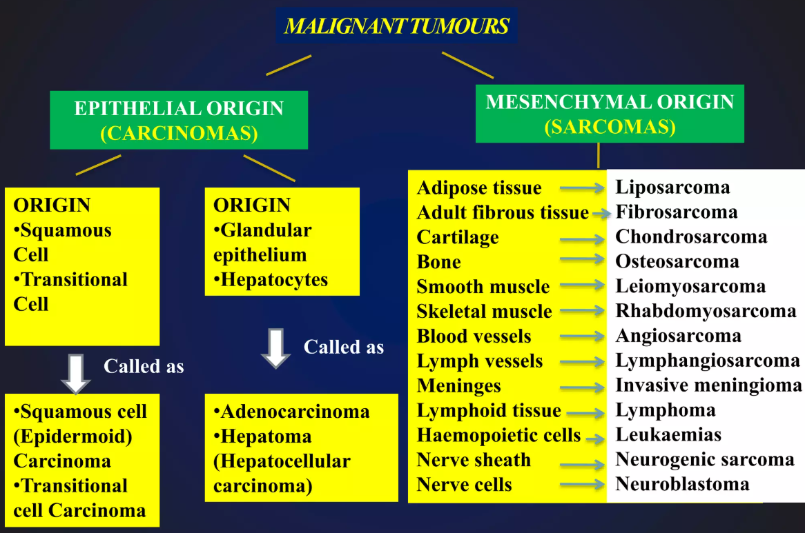
Tumour classification
Tumours are classified depending on the cell type from which they arise.
The five main categories are carcinoma, sarcoma, leukaemia, lymphoma and myeloma (classified together), and central nervous system cancers.
Approximately 90% of human cancers fall under the carcinoma category, consisting of malignancies that arise in epithelial cells.
Tumours can also be further classified depending on their tissue or organ of origin, for example erythroid leukaemias arise from precursors of erythrocytes.
https://frontlinegenomics.com/a-guide-to-cancer-genomics/
https://www.slideshare.net/slideshow/neoplasia-introduction-nomenclature-classification-of-tumours/225776576

Slide 18
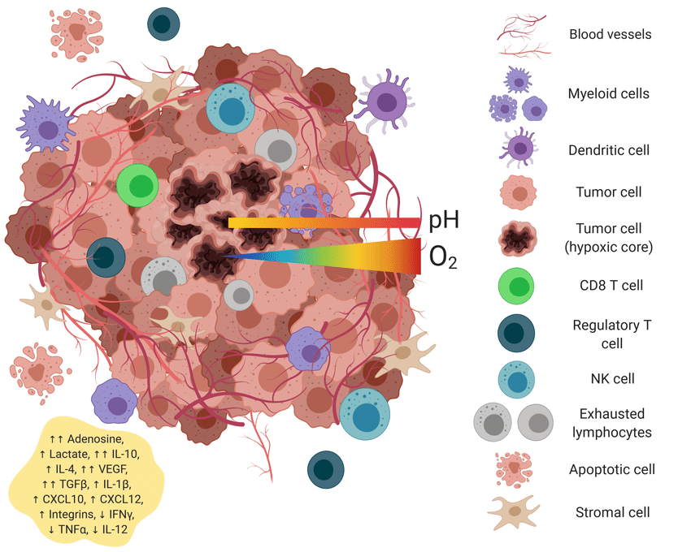
The tumour microenvironment
Tumours rely on the local environment surrounding them for their continued survival. The tumour microenvironment (TME) is composed a diverse range of cell types – including tumour cells, immune cells, and endothelial cells – which are held together by components of the extracellular matrix.
Tumour cells communicate with the TME using signalling molecules (such as cytokines and growth factors) to manipulate the activity of non-tumour cells in their favour.
The TME is now known to be a critical factor in tumour progression and cancer pathogenesis. At the early tumour initiation stage, cancer cells are detected by the innate immune system, which infiltrate the primary tumour site.
However, as tumour growth progresses, cancer cells modulate the activity of surrounding immune cells (such as macrophages and fibroblasts) to evade immune detection and promote tumour progression.
Once the tumour is fully established, the TME also plays a role in the invasion and spread of cancerous cells into the bloodstream and secondary tissues.
https://frontlinegenomics.com/a-guide-to-cancer-genomics/
https://en.wikipedia.org/wiki/Tumor_microenvironment

Slide 19
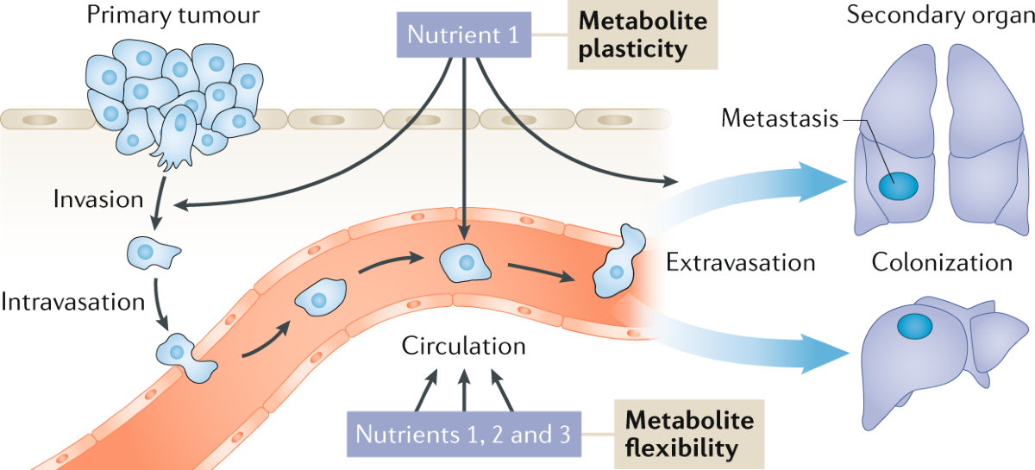
Cancer metastasis
The spread of cancerous cells to a secondary site within the body (metastasis) is the primary cause of death for over 90% of cancer patients.
Despite the importance of metastasis on patient prognosis, there are still many unanswered questions as to what drives cancer cell migration and how it can be prevented.
Normal cells will migrate through the body until they contact another cell, get stuck, and create a uniform array of cells.
On the other hand, tumour cells exhibit a reduced expression of cell surface adhesion molecules, meaning that when they contact other cells, they don’t get stuck. Instead, tumour cells continue to migrate over and around other cells, and (in culture) will grow in a disorderly and often multi-layered pattern.
This lack of adhesion molecules plays an important role in the proliferation, invasion, and metastasis of cancer.
https://frontlinegenomics.com/a-guide-to-cancer-genomics/
https://www.nature.com/articles/s41568-020-00320-2

Slide 20
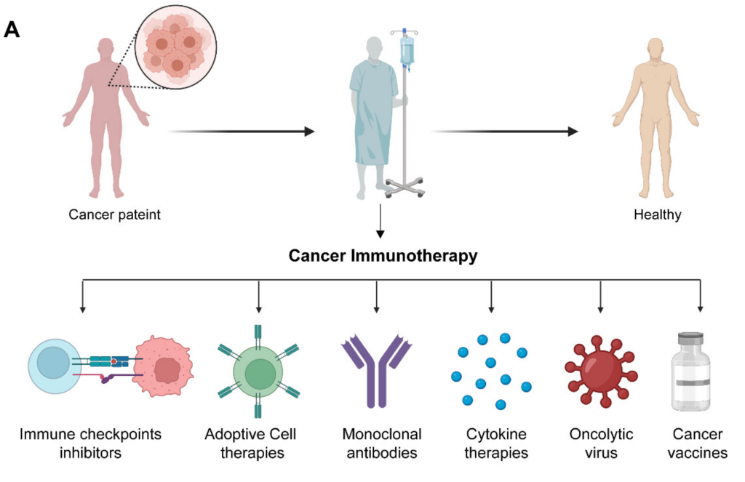
Immunotherapy and precision oncology
In a healthy individual, the immune system responds to “foreign” cells (such as cancer) by attacking and eliminating them.
Unfortunately, cancer cells have their own strategies for evading this immune response, leading to further proliferation and potential metastasis.
The traditional course of action is to treat the disease using surgery, chemotherapy, or radiotherapy (or some combination of these).
However, many patients simply do not respond to these established therapies.
Immunotherapy – a type of biological therapy – is a treatment strategy focused on harnessing the power of the patient’s immune system to attack cancer and stunt its development.
It shows great promise as a bespoke therapy for cancers that do not respond to traditional treatments and could improve quality of life for many patients. There are several immunotherapy treatments available for patients (see Figure 2).
https://frontlinegenomics.com/a-guide-to-cancer-genomics/
https://www.nature.com/articles/s41568-020-00320-2

Slide 21
Immunotherapy and precision oncology
In a healthy individual, the immune system responds to “foreign” cells (such as cancer) by attacking and eliminating them.
Unfortunately, cancer cells have their own strategies for evading this immune response, leading to further proliferation and potential metastasis.
The traditional course of action is to treat the disease using surgery, chemotherapy, or radiotherapy (or some combination of these).
However, many patients simply do not respond to these established therapies.
Immunotherapy – a type of biological therapy – is a treatment strategy focused on harnessing the power of the patient’s immune system to attack cancer and stunt its development.
It shows great promise as a bespoke therapy for cancers that do not respond to traditional treatments and could improve quality of life for many patients. There are several immunotherapy treatments available for patients (see Figure 2).
The various immunotherapy approaches for cancer treatment.
Sourced from Mishra et al, 2022.
https://frontlinegenomics.com/a-guide-to-cancer-genomics/

Slide 22
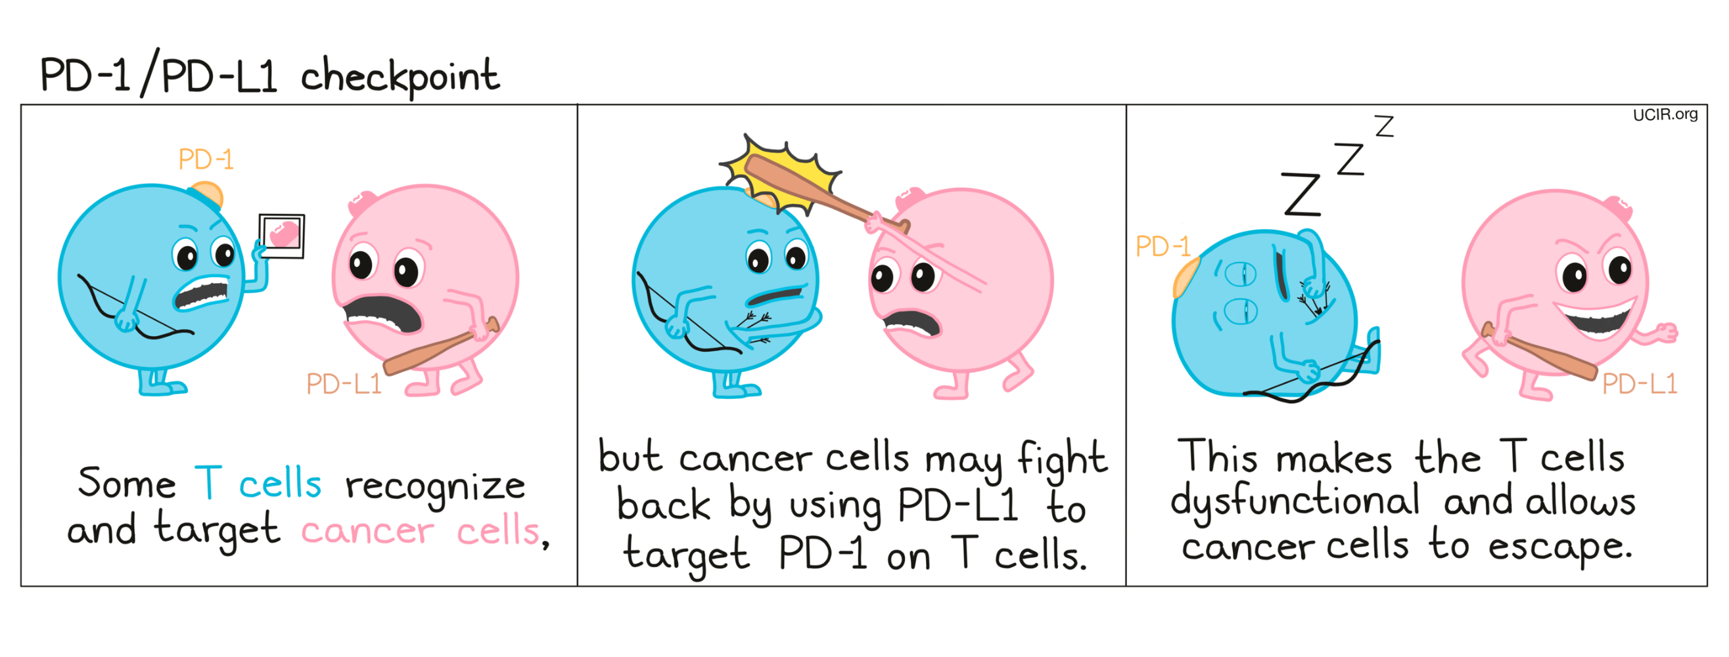
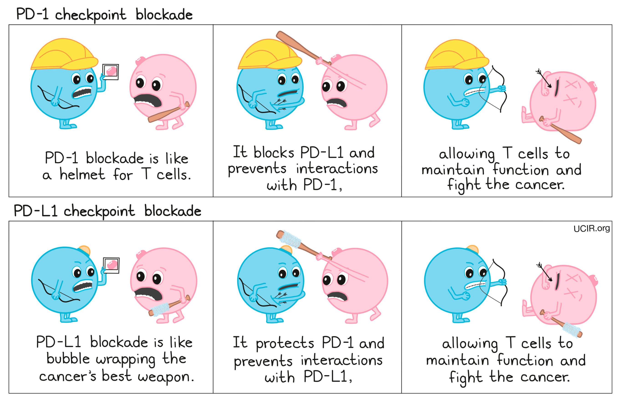
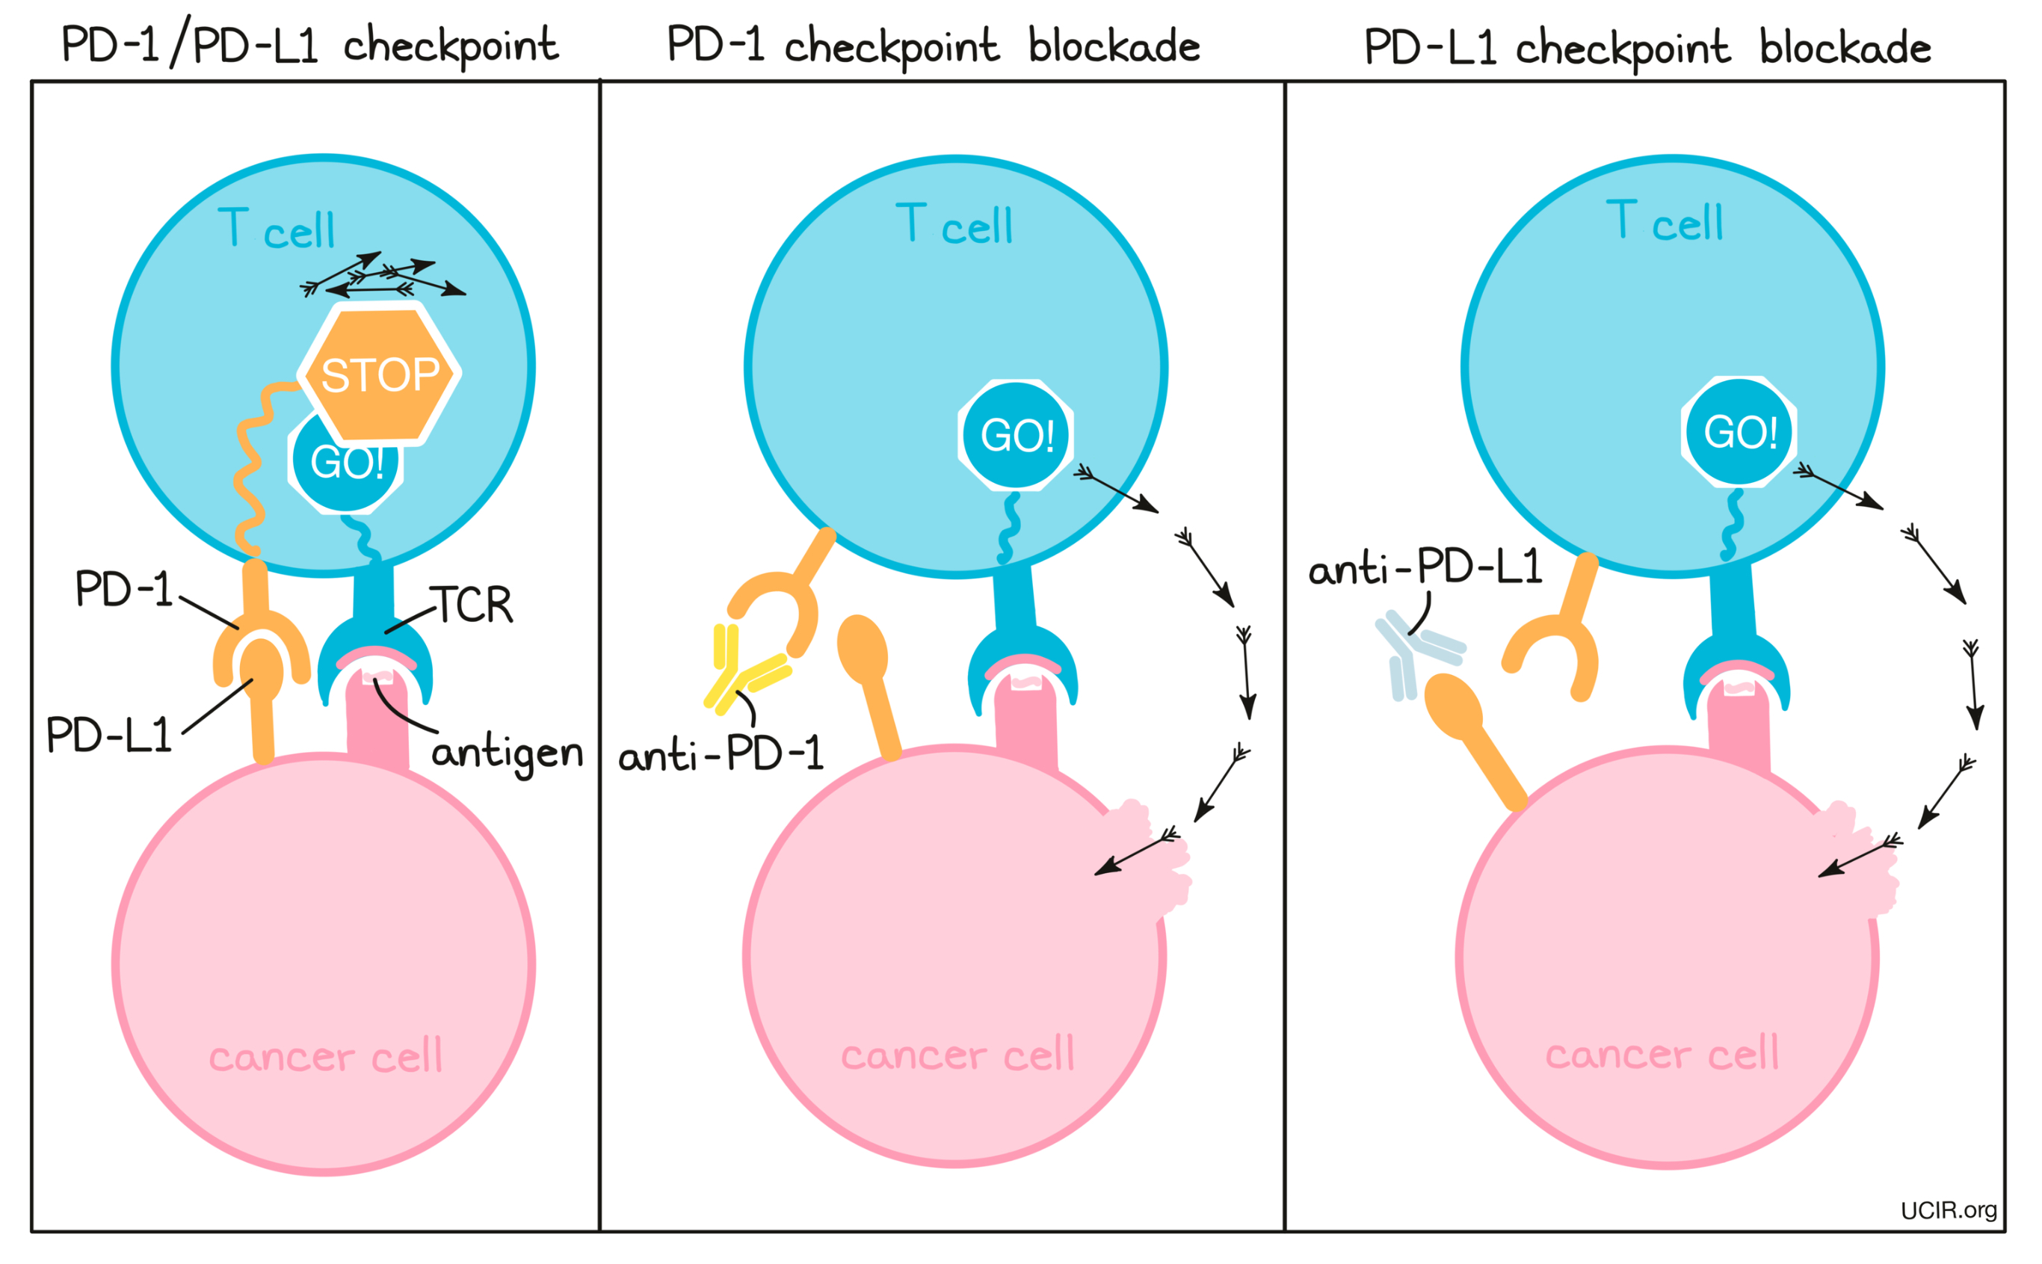
Immunotherapy: Checkpoint inhibitors
Immune checkpoint inhibitors are drugs that are able to block T cell activation and regulate hyperactivation of the immune system.
The most well-known examples are antibodies that block the cytotoxic T lymphocyte antigen 4 (CTLA4) and programmed cell death 1 (PD-1) proteins.
These drugs are used to treat melanoma, renal cell carcinomas, colorectal cancers, non-small cell lung cancer, head and neck cancer, cervical cancer, endometrial cancer, bladder cancer and breast cancer – with more cancer types on the horizon.
https://frontlinegenomics.com/a-guide-to-cancer-genomics/
https://www.ucir.org/therapies/checkpoint-blockade

Slide 23
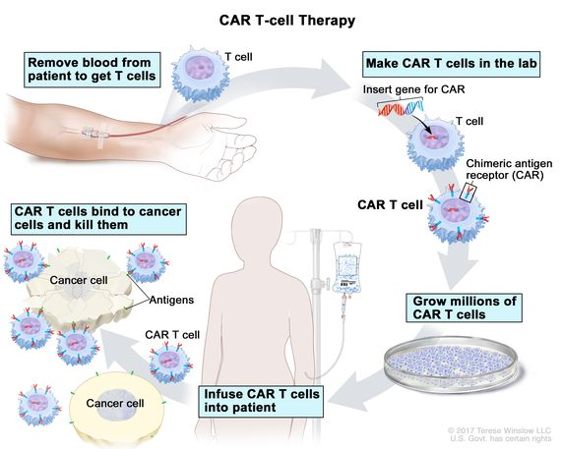
Immunotherapy: CAR T-cell therapy
Chimeric antigen receptor (CAR) T-cell therapy – otherwise known as T-cell transfer therapy – is a specialised immunotherapy in which changes are made to the genes of a patient’s T-cells to increase their efficiency in recognising and destroying cancer.
Once these tweaks have been made in the lab, the T-cells are grown in batches and put back into the body via an intravenous drip.
CAR T-cell therapy is currently used to treat children with some forms of leukaemia, and in adults with lymphoma.
CAR T-cell therapy: A type of treatment in which a patient’s T cells (a type of immune cell) are changed in the laboratory so they will bind to cancer cells and kill them.
Blood from a vein in the patient’s arm flows through a tube to an apheresis machine (not shown), which removes the white blood cells, including the T cells, and sends the rest of the blood back to the patient.
Then, the gene for a special receptor called a chimeric antigen receptor (CAR) is inserted into the T cells in the laboratory.
Millions of the CAR T cells are grown in the laboratory and then given to the patient by infusion. The CAR T cells are able to bind to an antigen on the cancer cells and kill them.
https://frontlinegenomics.com/a-guide-to-cancer-genomics/
https://www.cancer.gov/publications/dictionaries/cancer-terms/def/car-t-cell-therapy

Slide 24
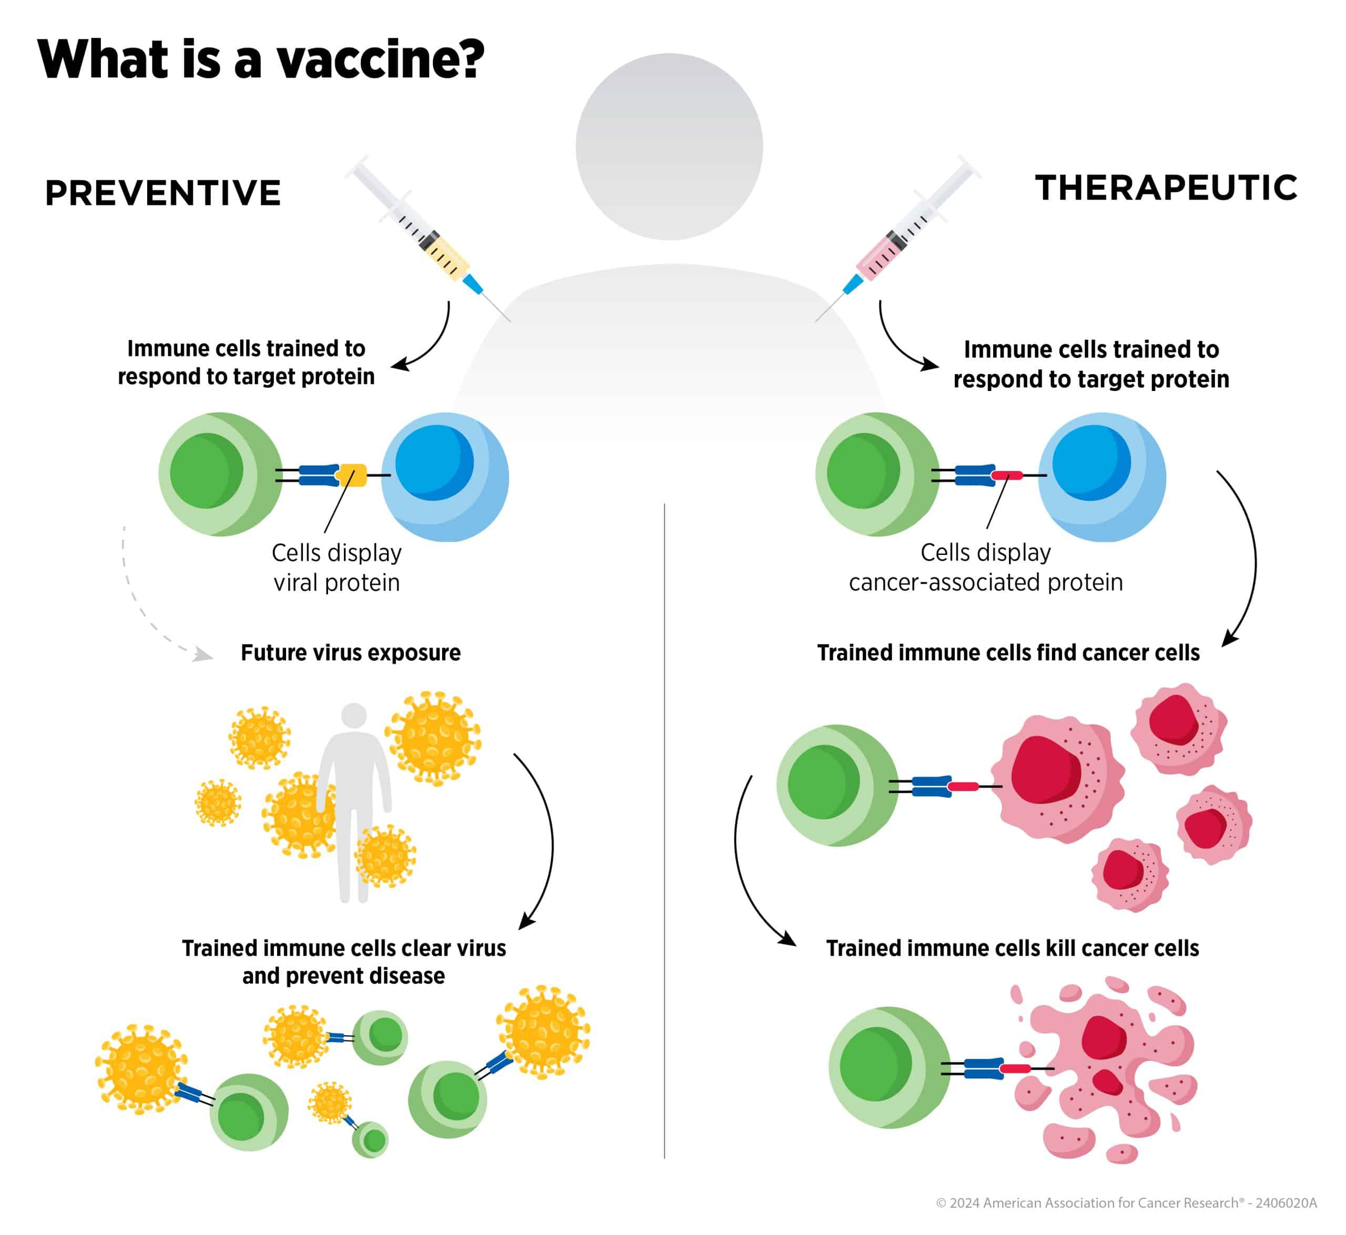
Cancer vaccines
There are two types of cancer vaccines: prophylactic and therapeutic.
Prophylactic vaccines are more similar to a traditional vaccine and are used to prevent infection by an oncogenic virus.
One common example is the human papillomavirus vaccine against cervical cancer.
Therapeutic vaccines harness tumour-associated antigens to help the immune system eliminate cancer cells.
Non-cancerous cells are protected from this attack as they either do not display these antigens or do not possess the antigens in high enough numbers to be targeted.
Therapeutic cancer vaccine types:
Protein-based Vaccines
RNA-based Vaccines
DNA-based Vaccines
Viral- and Bacterial-based Immune Stimulants
Vaccines prevent or treat disease by training the immune system to attack viruses or cancers, respectively
https://frontlinegenomics.com/a-guide-to-cancer-genomics/
https://www.cancer.gov/publications/dictionaries/cancer-terms/def/car-t-cell-therapy

Slide 25
Cancer Genomic Databases
The Cancer Genome Atlas (TCGA): A joint project between the National Cancer Institute (NCI) and the National Human Genome Research Institute (NHGRI) that generated over 2.5 petabytes of genomic data. The data is publicly available through the NCI Genomic Data Commons (GDC).
cBioPortal: Provides visualization, analysis results, and downloads of large-scale cancer genomics data sets.
Oncomine: A bioinformatics initiative that collects, standardizes, analyzes, and delivers cancer transcriptome data.
MENT: A database of methylation and Expression in both normal and tumor tissues.
COSMIC (Catalogue of Somatic Mutations in Cancer): A database that classifies genes into tiers based on their activity and mutations in cancer.
Cancer Genomics Cloud (CGC): A cloud platform that enables analysis, storage, and computation of large cancer datasets.

Slide 26
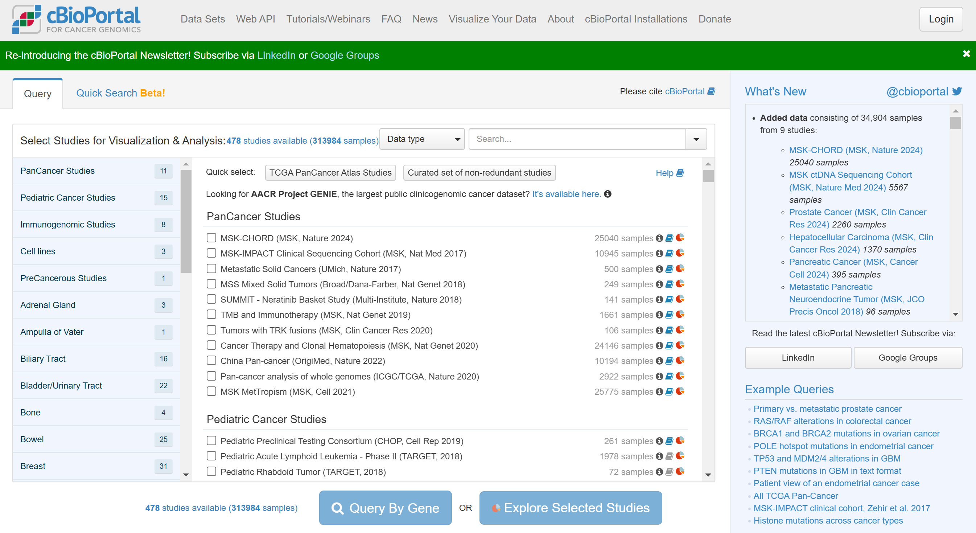
cbioportal.org
https://www.cbioportal.org/

Slide 27
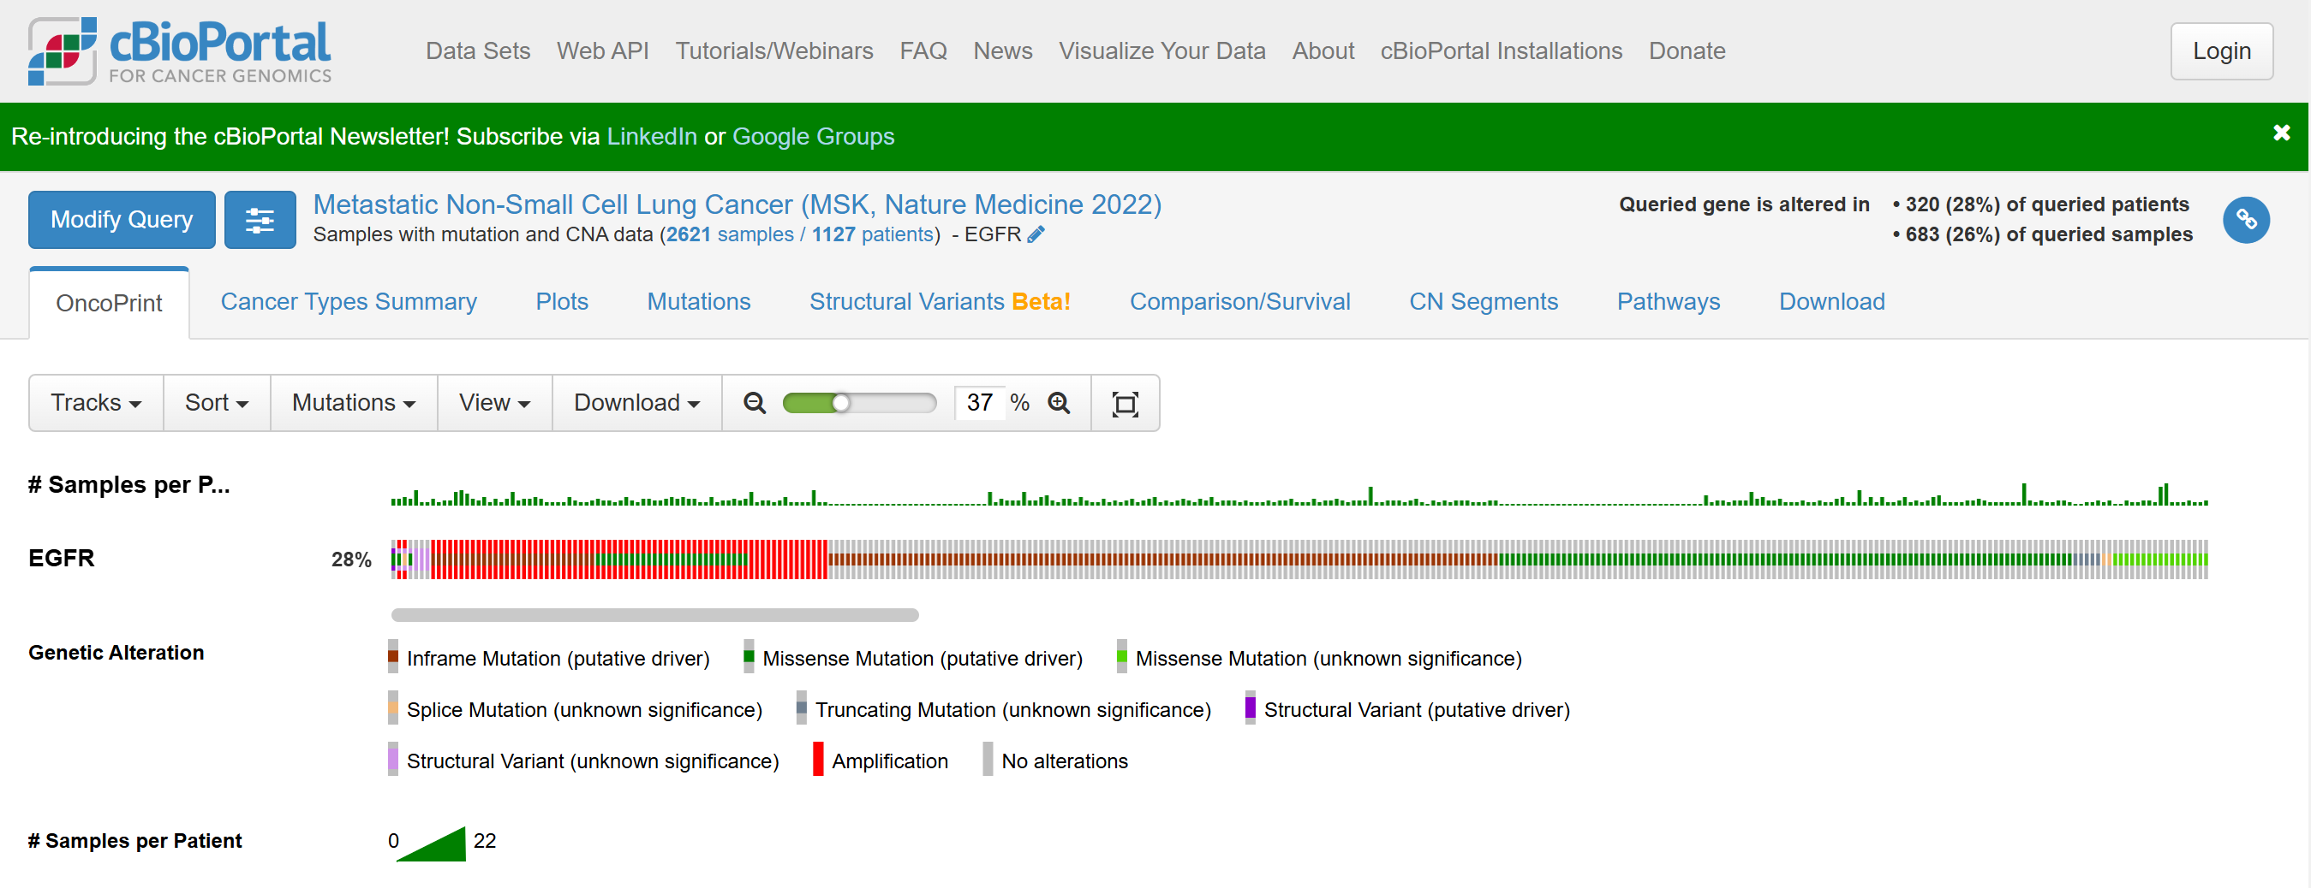
Lung cancer: EGFR
https://www.cbioportal.org/results/oncoprint?cancer_study_list=nsclc_ctdx_msk_2022&Z_SCORE_THRESHOLD=2.0&RPPA_SCORE_THRESHOLD=2.0&profileFilter=mutations%2Cstructural_variants%2Ccna&case_set_id=nsclc_ctdx_msk_2022_cnaseq&gene_list=EGFR&geneset_list=%20&tab_index=tab_visualize&Action=Submit

Slide 28
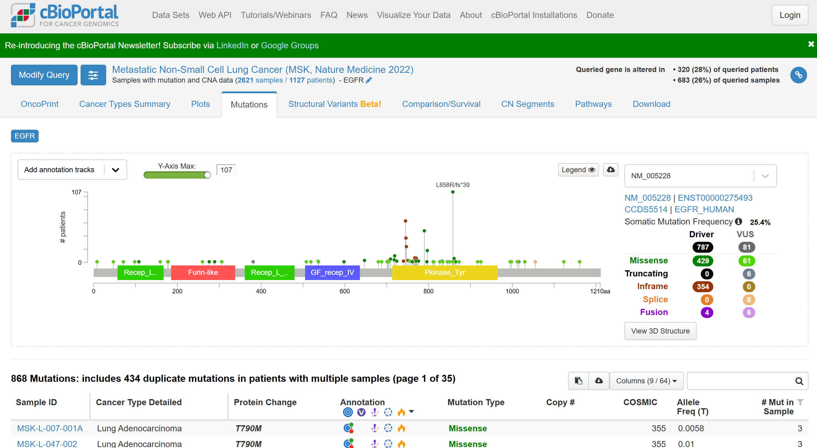
Lung cancer: EGFR
https://www.cbioportal.org/results/mutations?cancer_study_list=nsclc_ctdx_msk_2022&Z_SCORE_THRESHOLD=2.0&RPPA_SCORE_THRESHOLD=2.0&profileFilter=mutations%2Cstructural_variants%2Ccna&case_set_id=nsclc_ctdx_msk_2022_cnaseq&gene_list=EGFR&geneset_list=%20&tab_index=tab_visualize&Action=Submit

Slide 29
Xin chân thành cảm ơn!
Luu Phuc Loi, PhD
Zalo: 0901802182
Email: luu.p.loi@googlemail.com

